Slide 1
Company Overview 2017

Slide 2
Company Facts
GlobaLux Lighting LLC, headquartered in Ontario, CA, is a Southern California based supplier of a broad range of residential, commercial, and industrial lighting products, offered in LED and Fluorescent.
The GlobaLux Lighting LLC group has over 40 years of experience in manufacturing and supplying lighting products, and was formally established as an independent and privately-owned company brand in 2011.
GlobaLux lighting products include a comprehensive assortment of LED Bi-Level “Smart Lighting” Luminaires, LED and Fluorescent lighting fixtures, Decorative LED Kitchen & Bath fixtures, Outdoor Wall Packs, Decorative Outdoor Lanterns, Emergency Lighting, Exit Signs, and various lighting accessories.
GlobaLux offers lighting products with an uncompromising emphasis on energy efficiency, quality craftsmanship, superior materials, and optical performance. GlobaLux products carry a limited manufacturer’s warranty, ranging from 3 – 5 years.
At GlobaLux, we strive for constant improvement in offering great customer service, competitive pricing, stock allocations, new products, monthly promos, and on-time delivery, in order to give “Total Value” and a great experience in doing business with us. Through our network of in-house lighting engineers and flexible low-cost assembly operations, GlobaLux can also provide fast, cost-efficient, turnkey lighting solutions for most residential and commercial lighting projects.
GlobaLux has achieved compliance with the Buy American Act (1933) and the American Recovery and Reinvestment Act (2009), which lends to mutually beneficial arrangements in supplying lighting products to municipal and government projects in the USA.
As of 2017, GlobaLux maintains manufacturing and distribution for all lighting products through international and domestic operations located in Mainland China, Ontario, CA; Portland, OR; and Minneapolis, MN.

Slide 3
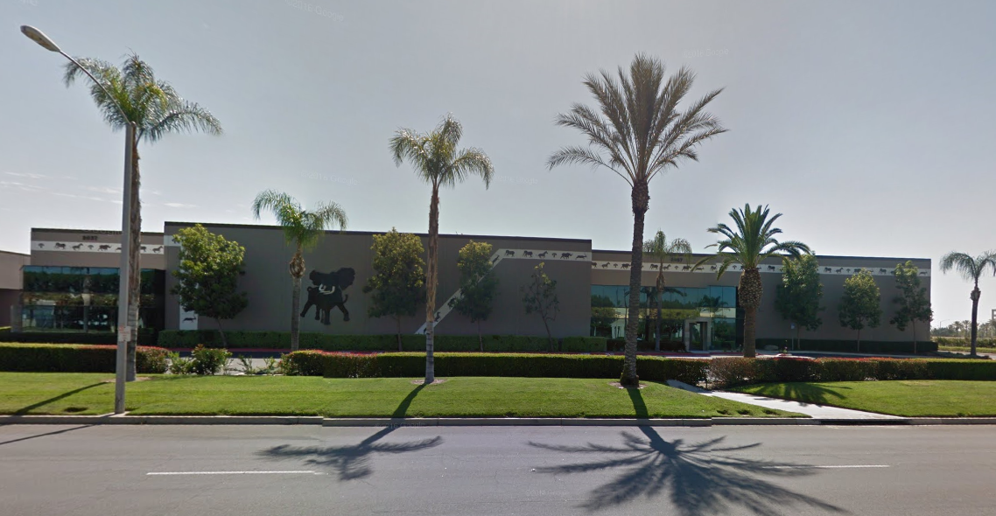
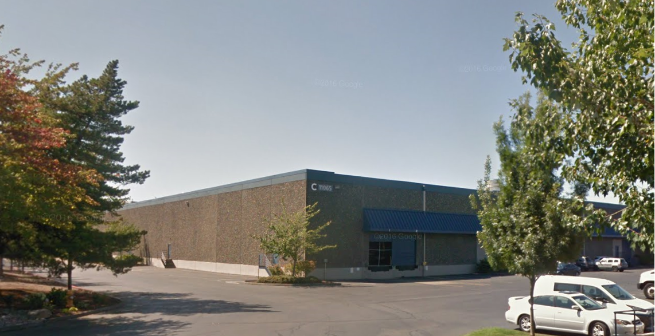
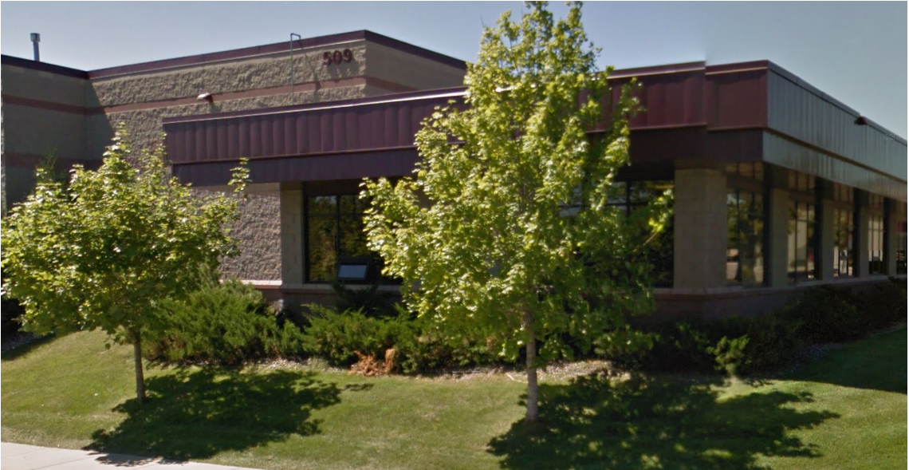
Domestic Operations
Business Hours 8am ~ 5pm PST Business Hours 8am ~ 5pm PST Business Hours 8am ~ 4pm CST
Ontario, CA
GlobaLux Lighting LLC - HQ
Main Office & Distribution Center
2037 S. Vineyard Avenue
Ontario, CA 91761
Tel (909) 591-7506
Fax (909) 590-3220
Orders@globaluxlighting.com
Portland, OR
Satellite Distribution Center
11065 SW 11th Street,
Unit #300
Beaverton, OR 97005
Tel (909) 591-7506
Fax (952) 590-3220
Orders@globaluxlighting.com
Minneapolis, MN
Satellite Distribution Center
C/O Infinity Group LTD
509 Shaughnessy Avenue
Long Lake, MN 55356
Tel (952) 473-2377
Fax (952) 473-0239
Orders@globaluxlighting.com

Slide 4
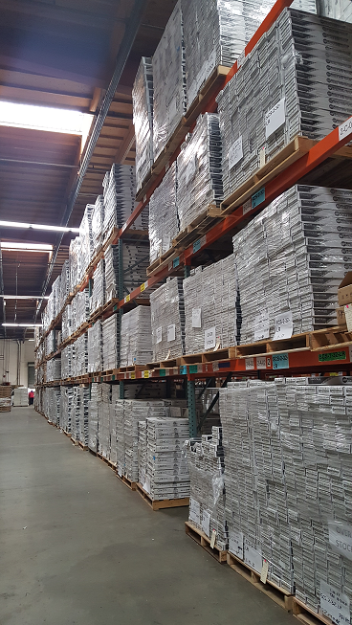
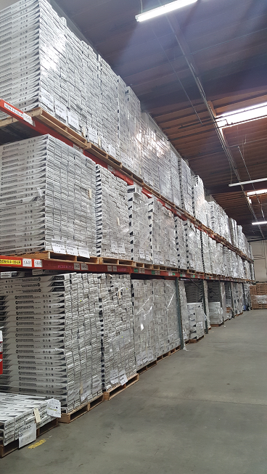
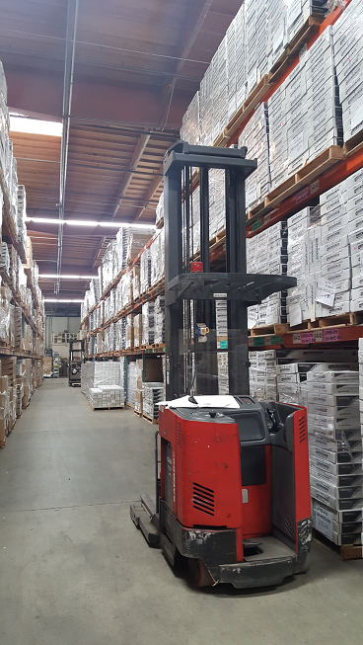
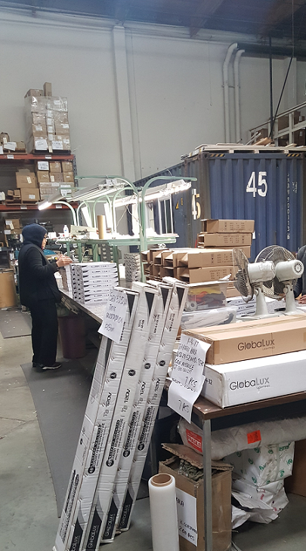
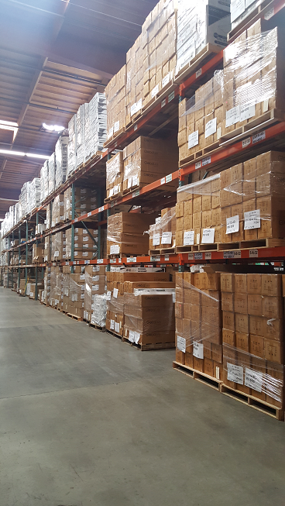
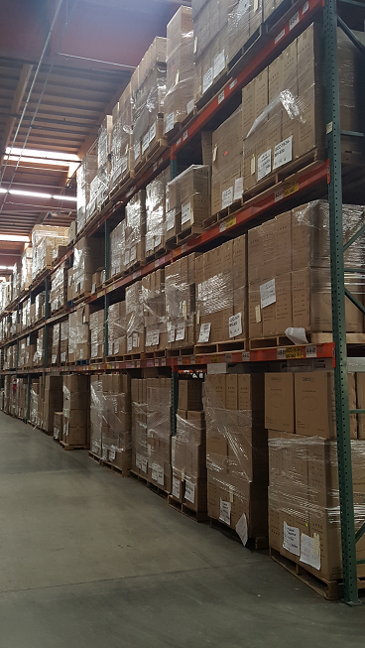
Domestic Operations - Ontario
Business Hours:
8am – 5pm PST
Will Call: 9am – 12pm, 1– 4pm
GlobaLux Personnel
Order Entry
Roxana Velasquez (orders@globaluxlighting.com)
Customer Service Representative (Order & Shipping Confirmations)
Angelica “Angel” Pineda (apineda@globaluxlighting.com)
Customer Service Manager (Production Scheduling, CSR Support)
Diane Teeters (dteeters@globaluxlighting.com)
Sales (Price Quotations, LTAs, NDAs, Catalogs, Marketing & Sales Items)
Zee Parekh (zee@globaluxlighting.com)
RMA (Returns) & Accounts Receivable
Diana Blade (AR@globaluxlighting.com)
Warehouse Manager / Shipping Supervisor
Jose Ruiz / Tony Hurtado
General Manager:
Nausheen Tabani (nausheen@globaluxlighting.com)

Slide 5
Customer Service Excellence
Quick Price Quotations
Same day service, competitive pricing always
Price matching may be typical on most similar items
Field sales representative(s) available anytime
Fast Stock Checks & Optional Product Allocations
In-house Customer Service Representative dedicated to your account
Improved 2017 product catalog shows “Quick Ship” items
Some items may be planned & allocated for projects, with Letter of Intent
Monthly Promotions, Volume Discounts, Hot Sheets
Each month features discounted pricing on select items
Volume discounts on orders of 50+ units (same item), in most cases
Hot sheets for special items, limited buy, and close-out merchandise
Flexible Product Sampling
Free (Item with small order value) or at Nominal Charge
Sample charge may be credited towards larger order
Free 30 Day evaluation may be available, with Letter Of Intent
Fast Order Entry & Processing
Orders placed by 12pm, may ship same day or by the next day
Orders placed after 1pm, typically ship 1-3 days
Free Prepaid Surface Freight Delivery
So. California – Min. $750 order value (1 shipment to 1 destination)
NorCal, Other States – Min. $1250 order value (1 shipment to 1 destination)

Slide 6
Sales & Service Excellence
Exhibit Customer Focused Methodology
Utilize a budget minded ideology to offer suitable products
Emphasize efficiency & effectiveness required for each application
Consider high reliability requirements vs. cost limitations
Provide Product Variety
Offer product options to maximize utility and cost-efficiency for all applications
Consider product interchangeability, replicability, and replaceability
Supply products with options, including battery back-up & other features
Maintain Price Competitiveness
View the competition and maintain fair & competitive market pricing at all times
Offer volume discounts on frequently purchased and/or high-volume items
Offer pricing that delivers total value for the product, service, delivery, and utility
Highlight Product Quality
Manufacture and supply quality finished goods, properly packaged, at all times
Stand behind GlobaLux product quality and GlobaLux brand at all times
Use quality materials and uphold top craftsmanship in manufacturing all items
Supply all products that are tested to be industry safe, reliable, and effective
Emphasize product certifications & efficiency standards (Energy Star/CA Title 24)
Develop & Grow Customer Relationships
Support customers, protect the supply chain, and observe distribution channels
Stand By Our Product Warranty
Residential items: 3 year limited manufacturer’s warranty
Commercial & Industrial items: 5 year limited manufacturer’s warranty

Slide 7
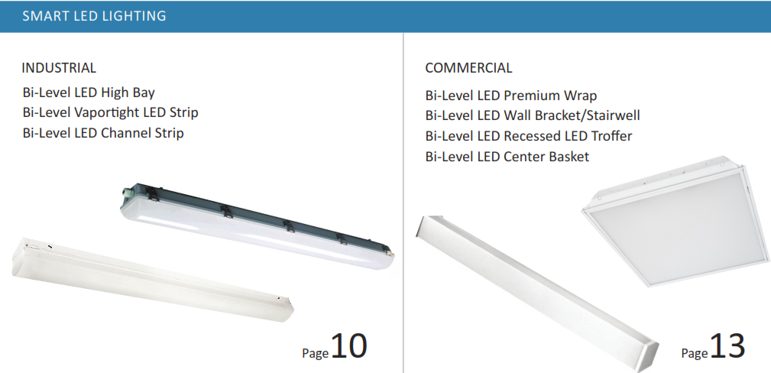
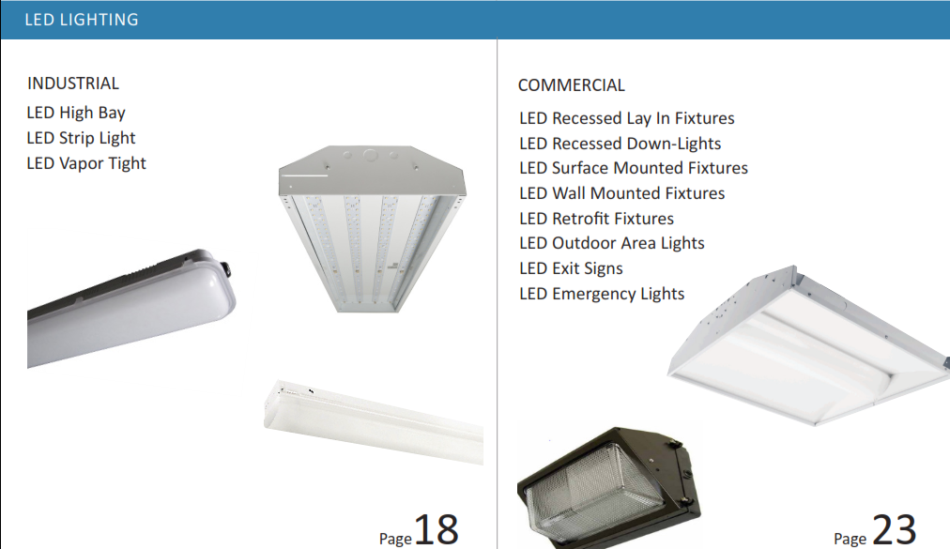
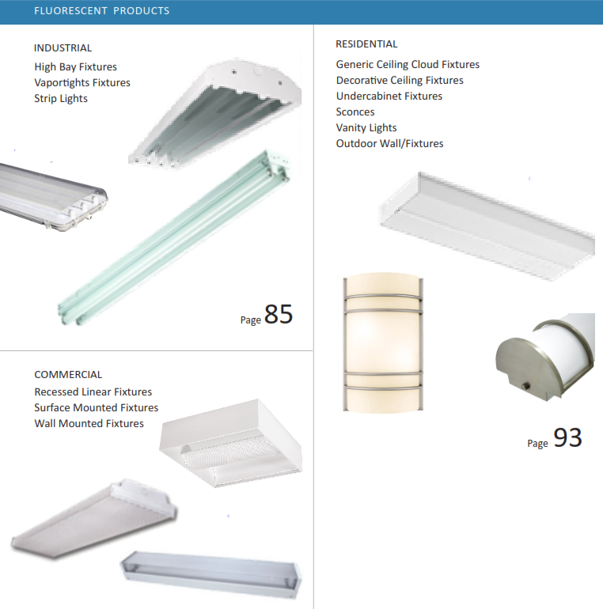
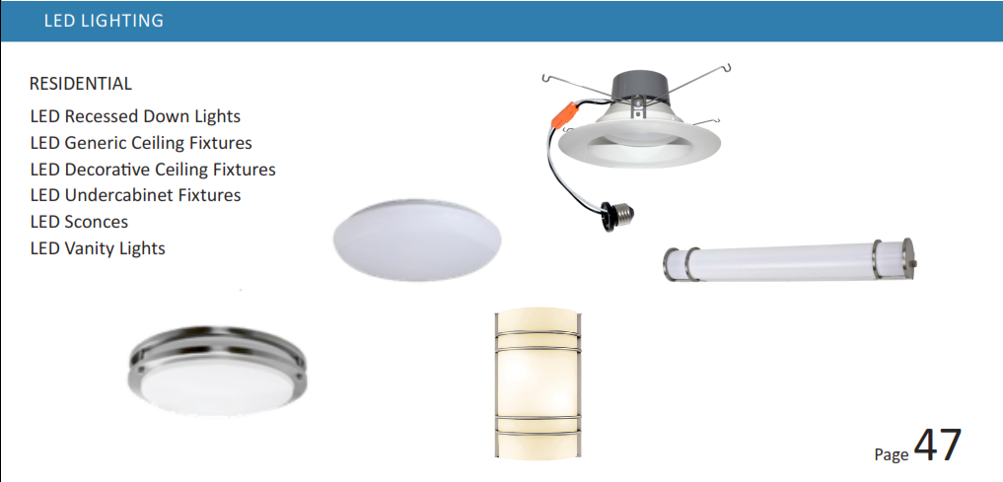
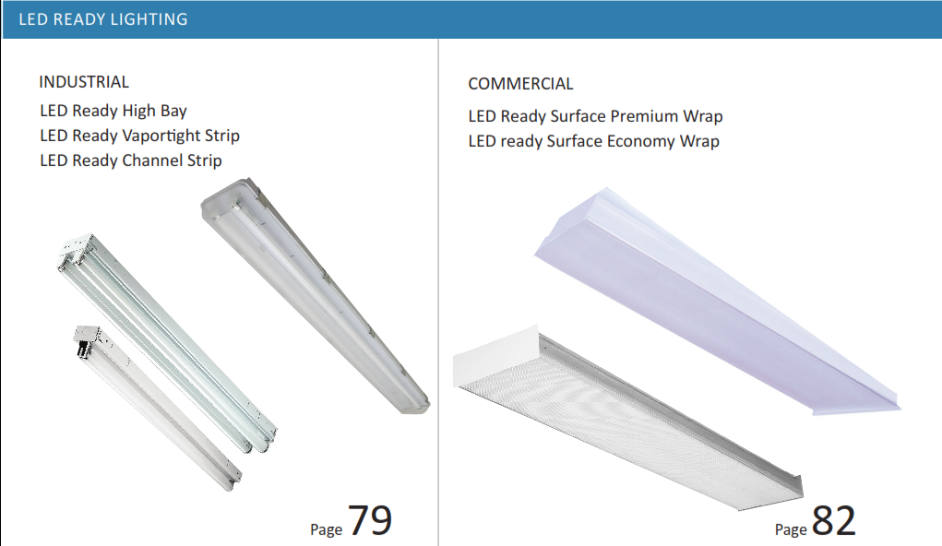
2017 Product Catalog
Our product catalog Table of Contents identifies all of our product categories:

Slide 8
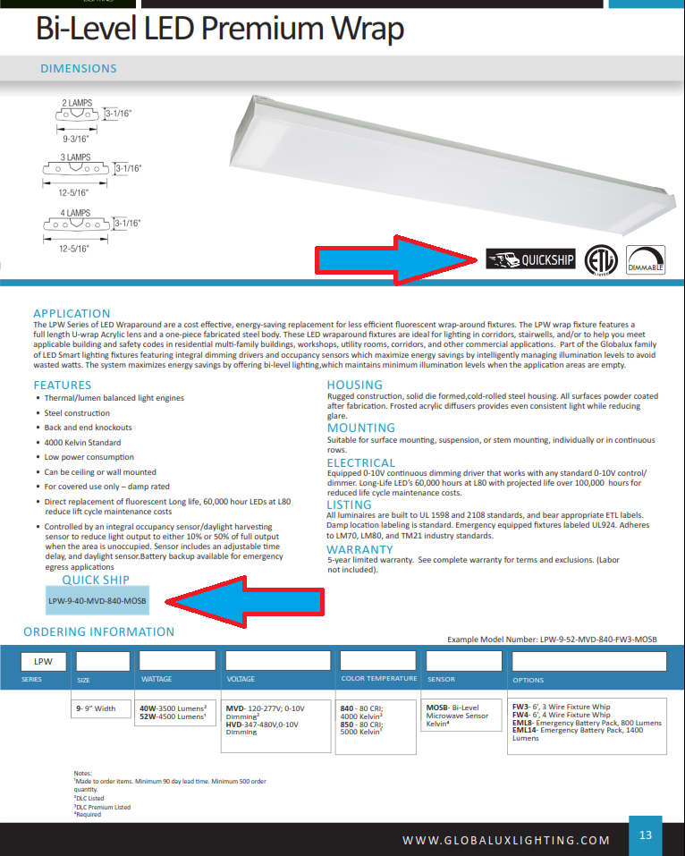
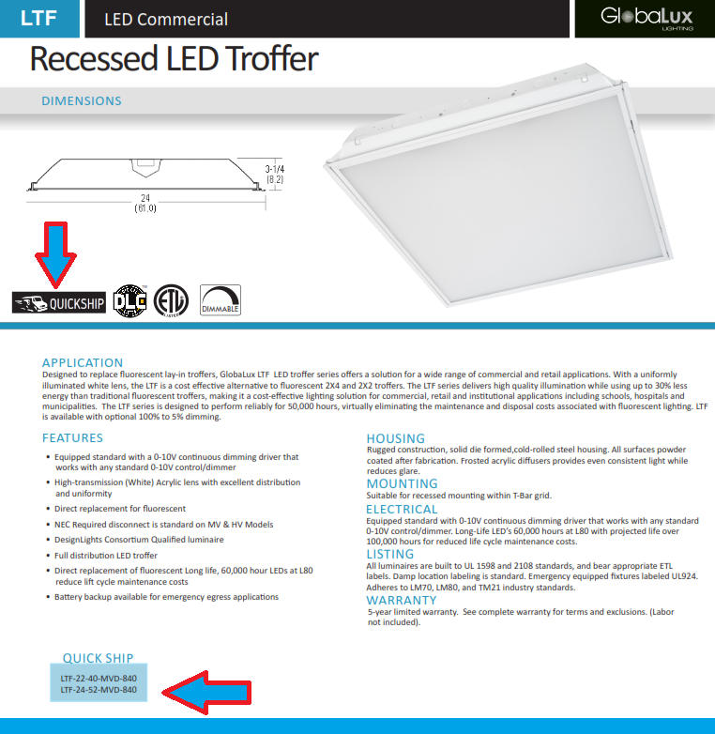
2017 Product Catalog
Our product catalog identifies “Quick Ship” stocking items:

Slide 9
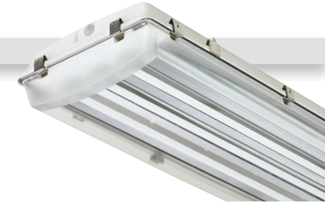
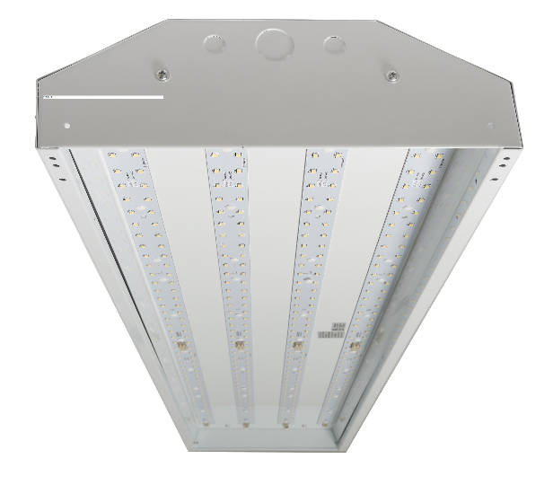
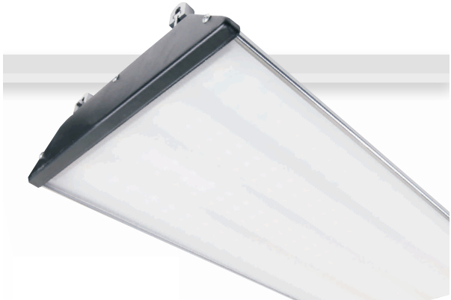
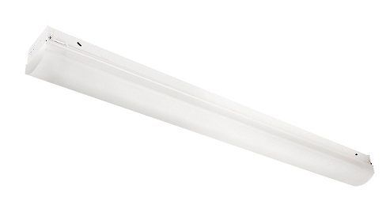
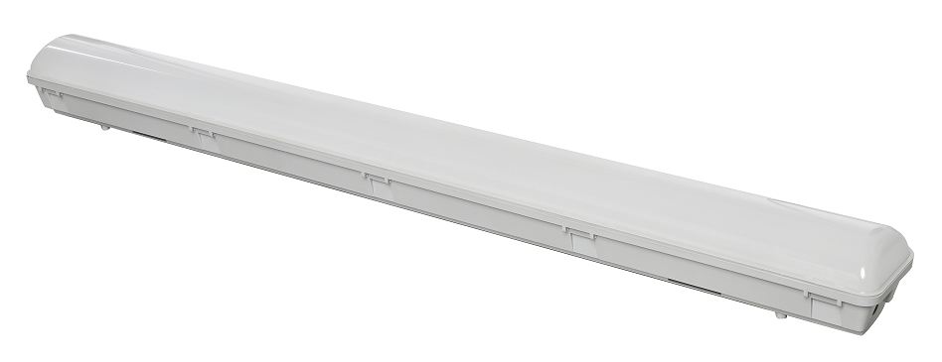
Industrial Products - LED
LED Vapor Tight High Bay (LVHB) LED Premium High Bay (LPHB)* LED High Bay (LHB)
LED Channel Strip (LCS)* LED Vapor Tight Strip (LVTS)*
*Fixture can be made available with a Bi-Level Microwave Sensor

Slide 10
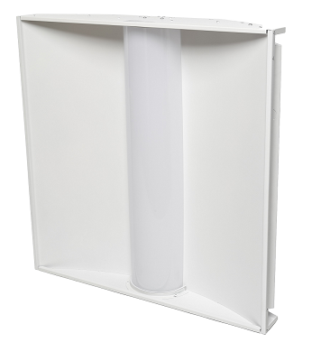
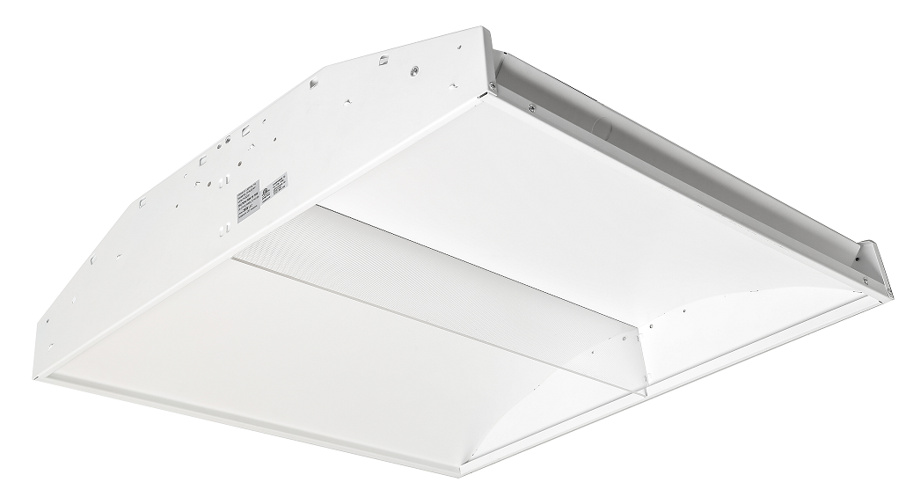
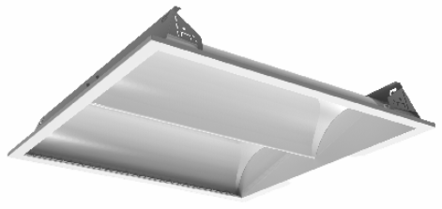
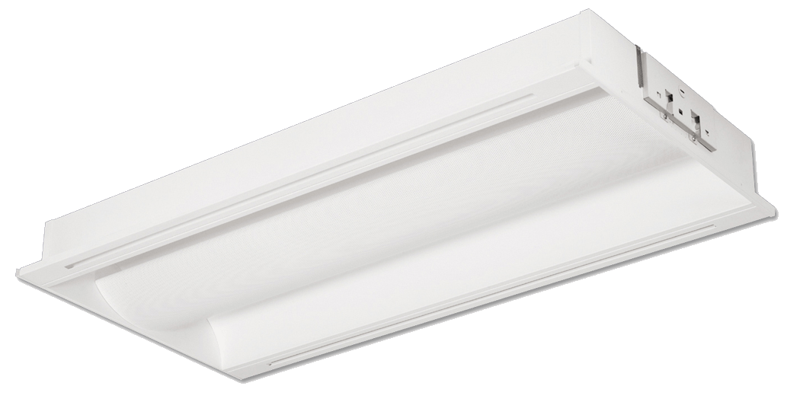
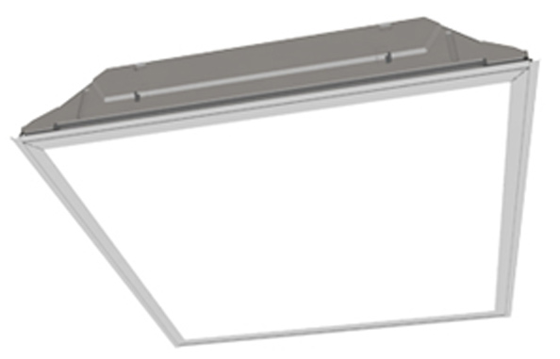
Commercial Products - LED
LED Center Basket (LCD)* Recessed LED Edge Lit (REL) Recessed LED Panel (RLP)
LED Recessed Side Lit Indirect (LSD) LED Recessed Direct Indirect (RCD) Recessed LED Troffer (LTF)*
*Fixture can be made available with a Bi-Level Microwave Sensor

Slide 11
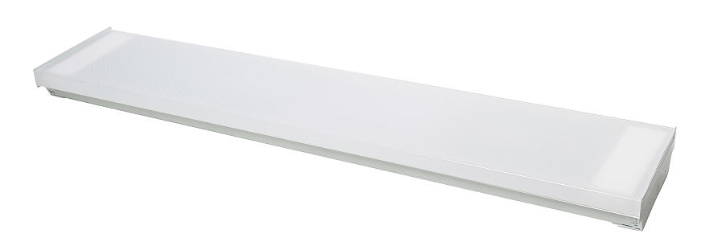
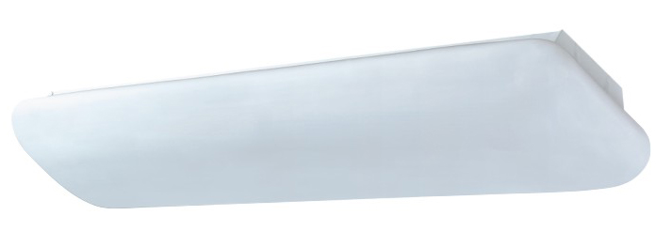
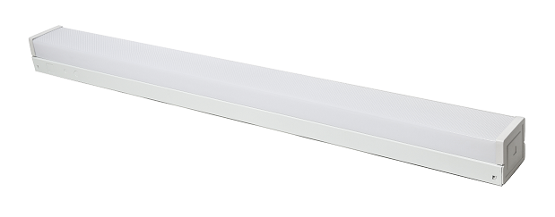
Commercial Products - LED
LED Economy Wrap (LEW) LED Premium Wrap (LPW)* LED Surface Mounted Puff (LSMP)
LED Wall Bracket/Stairwell LED Extruded Wall Bracket (LEVL) LED Glass T8 Tube (LT8)
Luminaire (LWLV)*
LED Glass T8 Hybrid Tubes (LHT8) Plug & Play LED T5 Tubes (LT5)
*Fixture can be made available with a Bi-Level Microwave Sensor

Slide 12
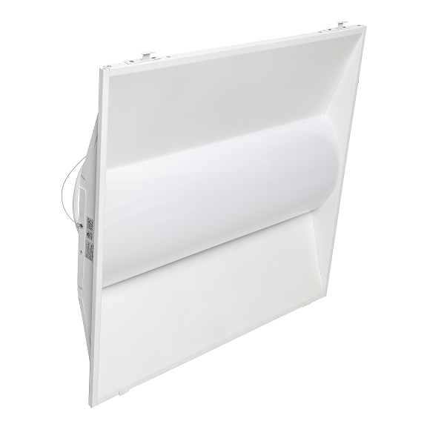
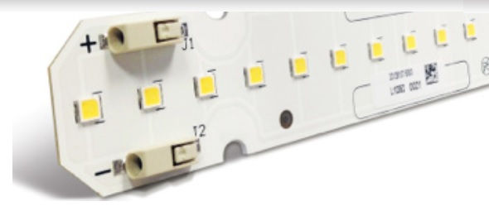
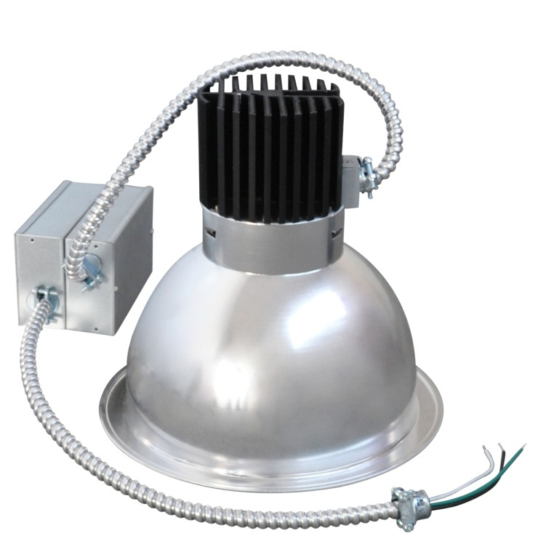
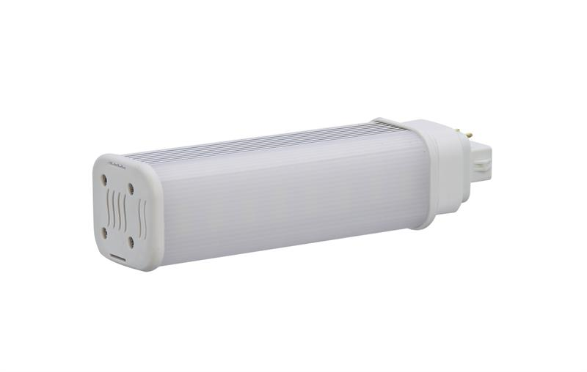
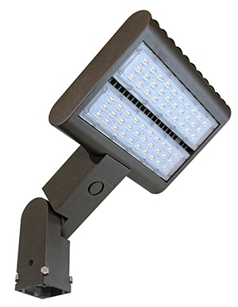
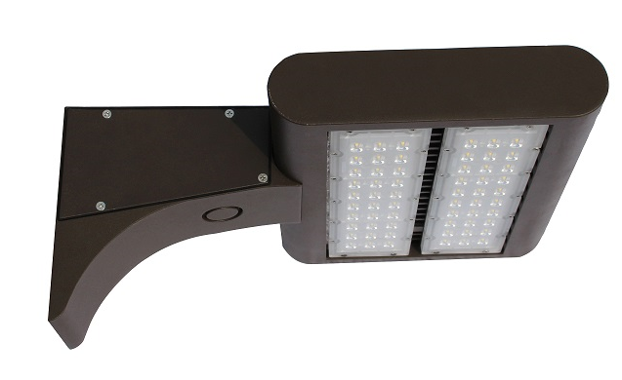
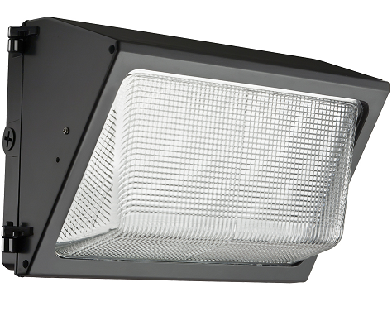
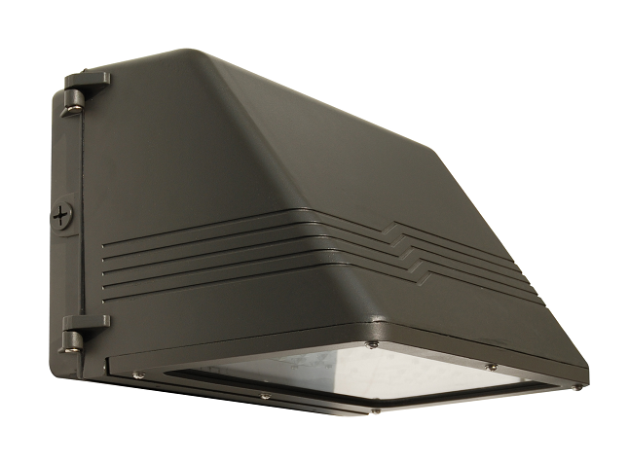
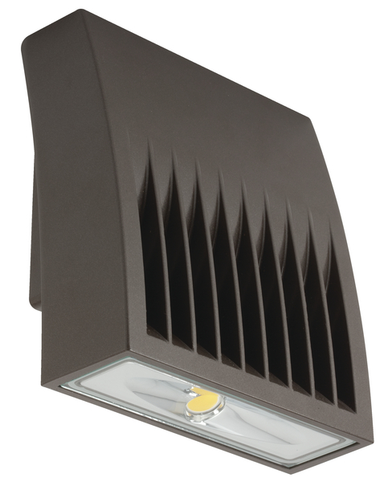
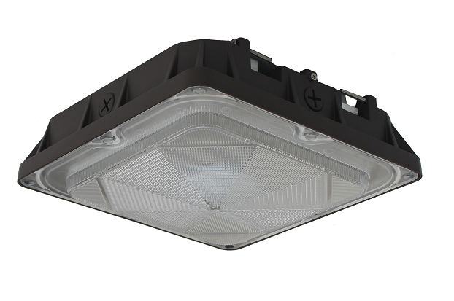
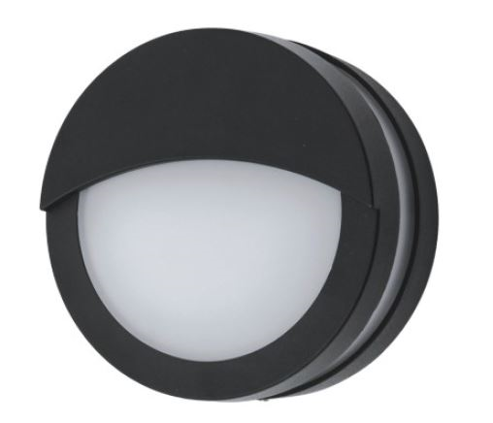
Commercial Products - LED
LED Door Retrofit (LDR) LED Troffer Retrofit Kit (LTK) Architectural Downlight Retrofit (ACR)
LED Plug and Play PL Lamp (LPL) LED Shoe Box Area Light (LSA) LED Wall Pack (LWP)
LED Cutoff Wall Pack (LCWP) LED Wall Pack (ACLW) LED Square Canopy (LSC) Architectural LED Bulkhead (ABH)

Slide 13
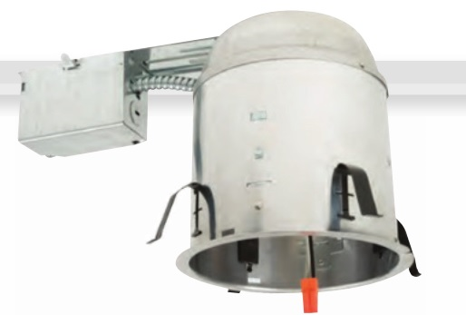
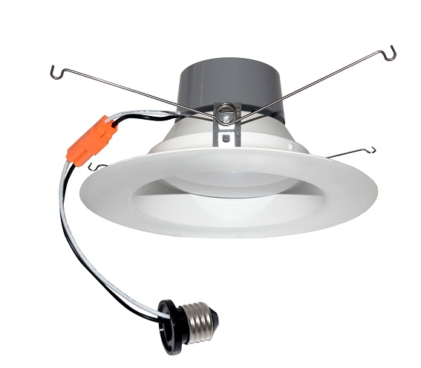
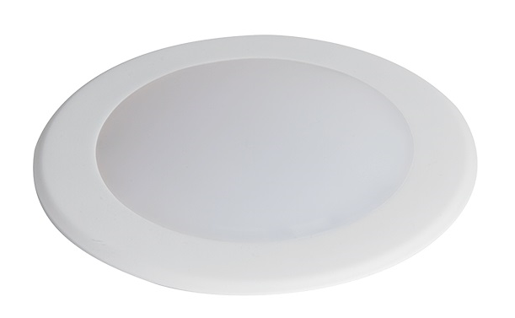
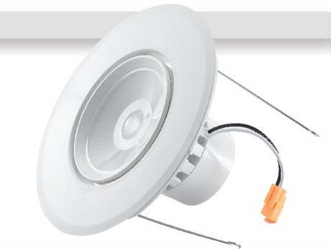
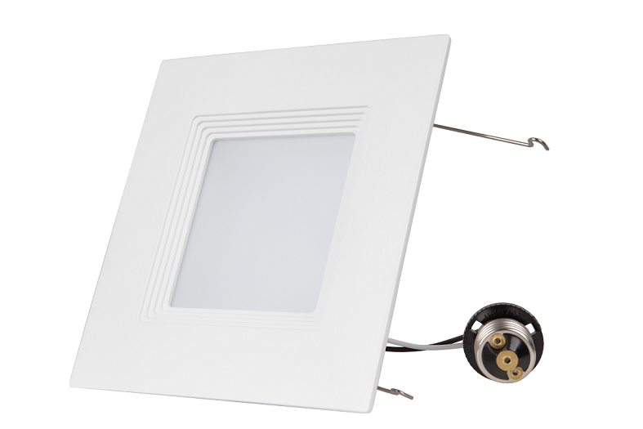
Residential Products - LED
LED Recessed Can (LRC) LED Retrofit Trim (LRT) LED Disk Light (LDL2)
LED Adjustable Retrofit Trim (LART) LED Square Retrofit Trim (LSRT)

Slide 14
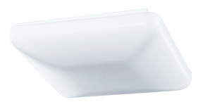
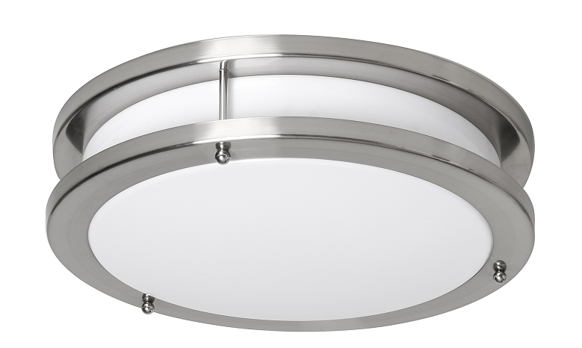
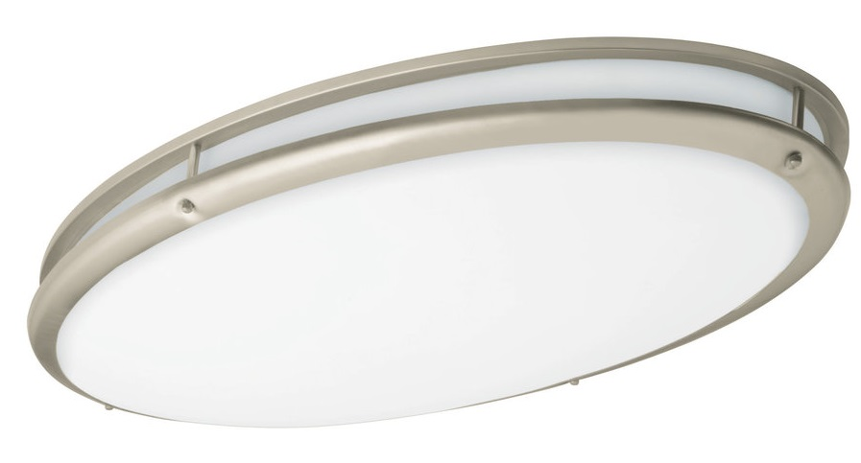
Residential Products - LED
LED Generic Ceiling Cloud (GCC) LED Generic Ceiling Square (GCS) LED Ringed Ceiling Fixture (DCR)
LED Oval Ringed Decorative Ceiling Light (DCRO)

Slide 15
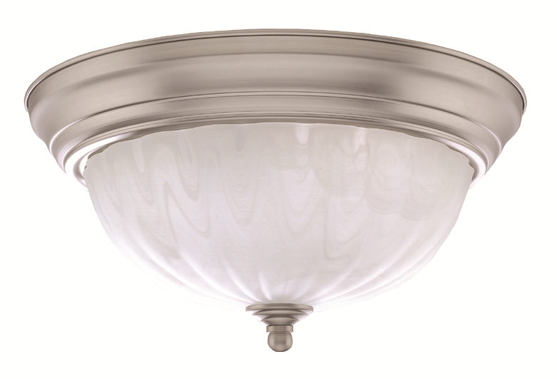
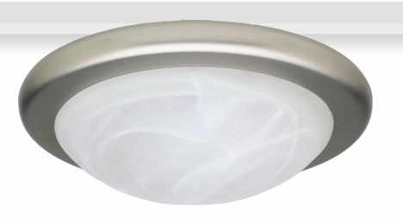
Residential Products - LED
Decorative LED Flush Mount (DCS) LED Decorative Ceiling Finial (DCF) LED Decorative Ceiling Fixture (DCL)
LED Undercabinet Fixture (UCL) LED Ringed Wall Sconce (RWS) LED Ringed Light Vanity (RVL)

Slide 16
Residential Products - LED
Architectural Wall Pack (AWP) Head Floodlight w/Motion Sensor (THF) Decorative Outdoor Lantern (DOL)
Decorative Outdoor Mission Decorative Outdoor Pocket Decorative Outdoor Coach
Lantern (DOF) Lantern (DOW) Lantern (DOA)

Slide 17
LED Exit / Emergency
Twin Head Emergency Light (THE) Fixed Optics Emergency Light (FOE) LED Exit Sign (LXS)
LED Combo Exit/Emergency LED Aluminum Exit Sign (AXS) Wet Location Exit & Combo
Sign (LCXS) Exit/Emergency Sign (WXS)
Edge Lit LED Exit Recessed Edge Lit LED Exit Architectural LED Remote Heads (RH)
Sign (EXS) Sign (REXS) AC/Emergency Light (AEL)

Slide 18
LED Ready Products
LED Ready Highbay (PHB) LED Ready Vapor Tight Strip (VTS) LED Ready Channel Strip (SCS)
LED Ready Surface Premium Wrap (SPW) LED Ready Surface Economy Wrap (SEW)

Slide 19
Industrial Products - Fluorescent
Premium High Bay (PHB) Vapor Tight High Bay (VTHB) Standard Channel Strips (SCS) Vapor Tight Strip (VTS)
Surface Economy Wrap (SEW) Surface Premium Wrap (SPW) Surface Mounted Puff (SMP) Recessed Center Direct Indirect (RCD)
Commercial Products - Fluorescent
Residential Products - Fluorescent
Thinline T5 Undercabinet (UC5) Extruded Vanity Light (EVL) Wall Bracket / Stairwell Luminaire (WLV)

Slide 20
2017 Product Catalog
Our product Index can be found at the back of the catalog, on catalog page 96:

Slide 21
GlobaLux Website
Product information and specification downloads can be found at our website: www.globaluxlighting.com

Slide 22
Web-Based Returns
Warrantable returns & product claims may also be filed online using GlobaLux’ web-based return system: http://globaluxrma.com/

Slide 23
We appreciate your business…
THANK YOU!

